Slide 1



MapMyIndia Automata
Achieving Operational Efficiency
CRYPTIX
Ridhima Bansal
Sarthak Aggarwal

Slide 2
INTRODUCTION
ADD A PLACE
Add a Place is used to crowdsource the request to add places like ATM, Hotel, Residential etc.
Move is a MapMyIndia product, which uses crowdsource information to update some of its information like:
1. Adding a new Location
2. Reporting a Incident
REPORTING AN INCIDENT
This is used to crowdsource reporting of an incident, which could be used in figuring out new routes. There are around 40-50 types of Incident Reporting possible

Slide 3
TECHNOLOGY STACK
MapMy
India APIs
Azure Computer Vision API
Azure Traffic Incident API
Natural Language Processing
Our solution uses powerful technologies in the backend to provide accurate result
Machine Learning Libraries
Python

Slide 4
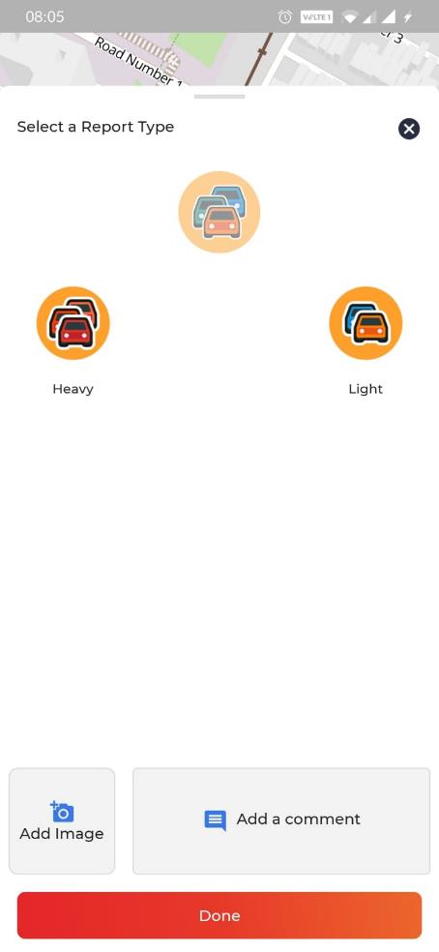
REPORTING A ISSUE
PROBLEM
STATEMENT
1
There are 40-50 types of incident that can be crowdsourced at different locations
There are manual operations and surveying done to verify the incident, and it could be time consuming
Verification of these incidents have to be real time, without any delay

Slide 5
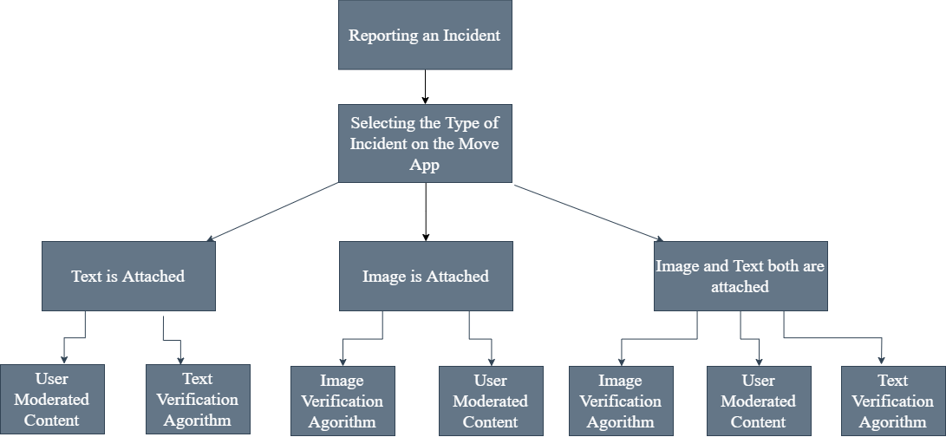
Solution Automating Report Incident
Image Freshness
Geotagging Algorithm
Timestamp Algorithm

Slide 6
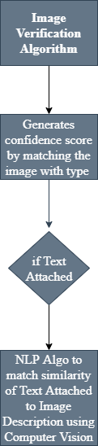
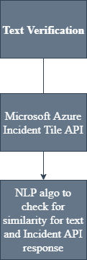
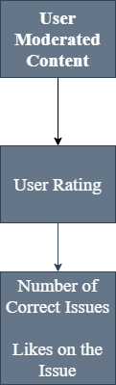
Solution Automating Report Incident

Slide 7
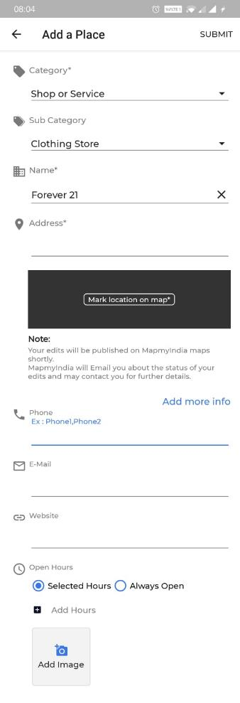
ADDING A PLACE
PROBLEM
STATEMENT
2
There are many people, bloggers who crowdsource information by adding a place
There are manual operations and surveying done to verify the incident, and it could be time consuming
Verification of these places can be automated have to be real time, without any delay

Slide 8
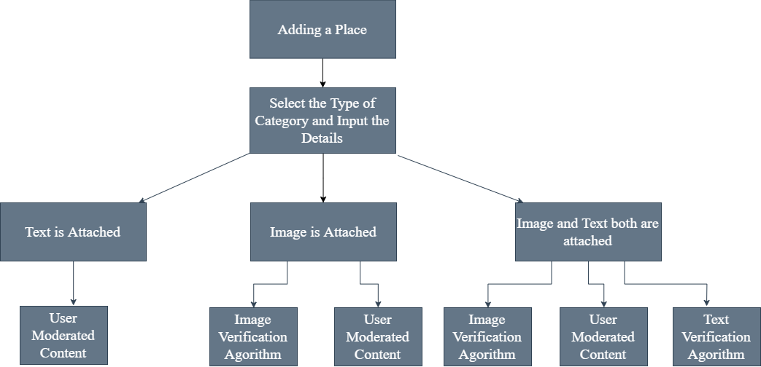
Solution Automating Add A Place
Image Freshness
Geotagging Algorithm
Timestamp Algorithm

Slide 9
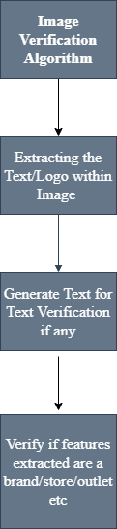
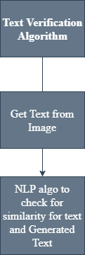
Solution Automating Add A Place

Slide 10
DEMO

Slide 11
THANK YOU
Ridhima Bansal
Sarthak Aggarwal

